Slide 3
Reward consumers
Badges (really cool ones)
Pedometer
Special quests: sightseeing , offbrand pokemon go ( stars?)
World leader board ( just position no names) ( just names???)
https://medium.com/android-news/a-beginners-guide-to-setting-up-opencv-android-library-on-android-studio-19794e220f3c

Slide 4
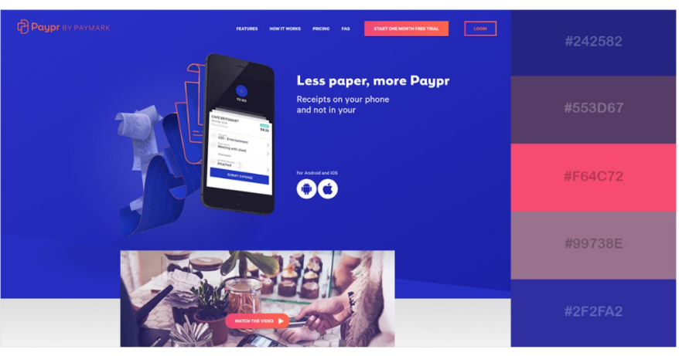
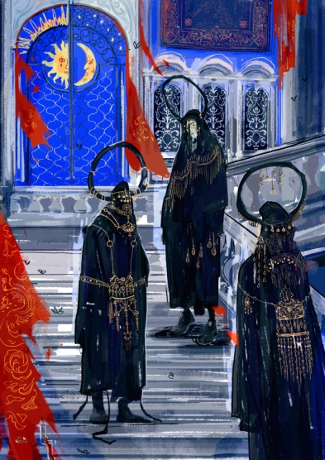
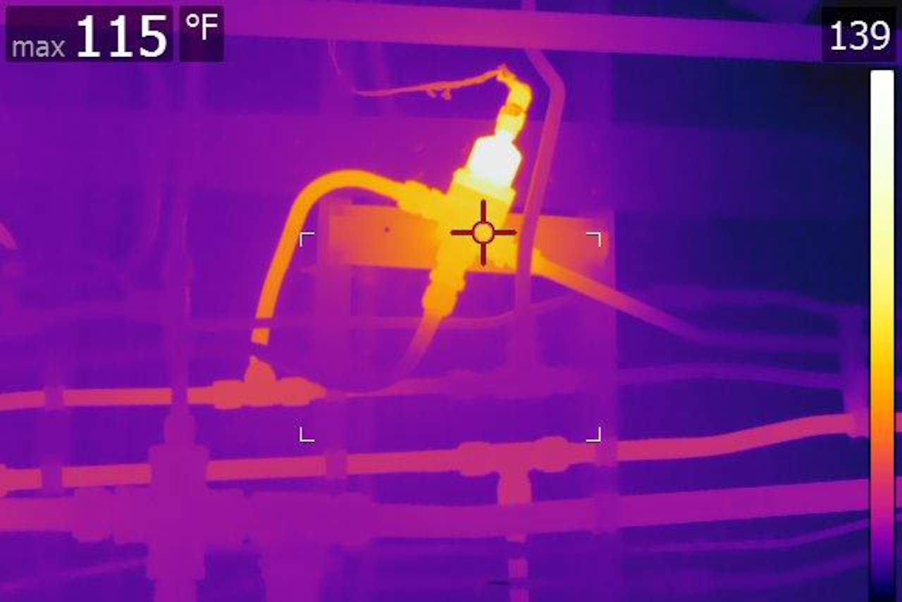

Slide 5
